Slide 1

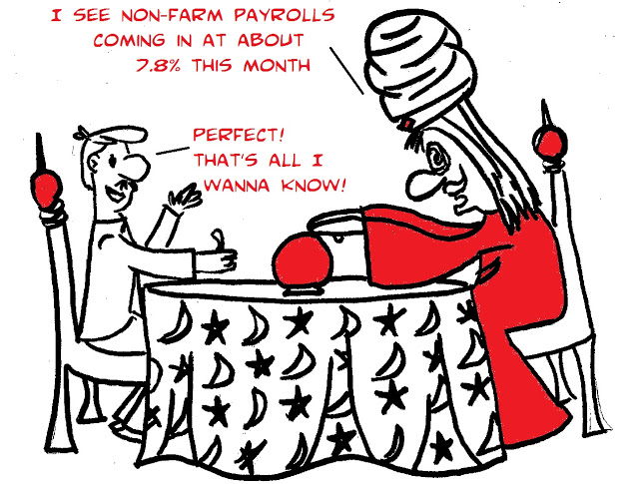
How to make predictions
Future Condition
I see a tidal wave approaching Darlost’s Island
  Existing predictive model
  Build new predictive model
  Expert elicitation
Will any mice survive?
Notes:
(Click) and cartoon will be replaced by text.

Slide 2
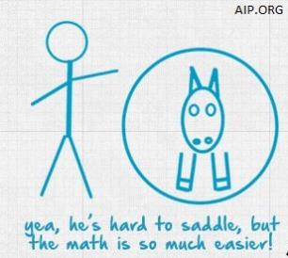
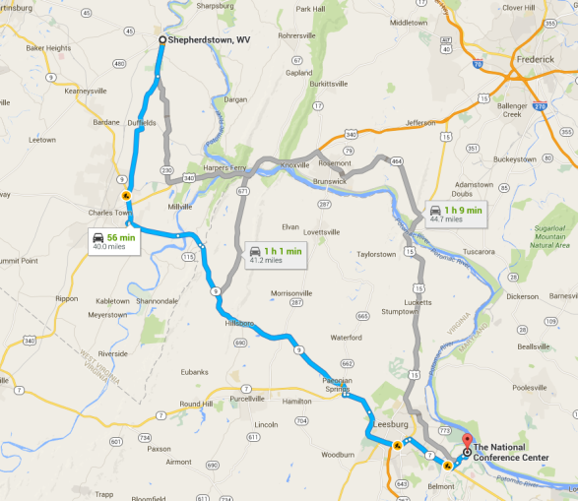
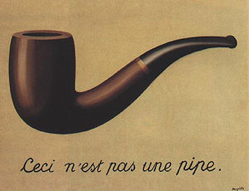
Predictive Modeling
Future Condition
  We all use models
    To predict, communicate, lend structure to our thinking
Notes:
Dave Smith Notes:
“This is not a pipe” by René Magritte
We use the term models in the broadest sense. We all use models all the time. For example, a map is a spatial model, and an estimate of drive time comes from a model that accounts for traffic patterns and legal speed limits throughout a specified route.
“All models are wrong and some are useful” said George Box, a well-known statistician. So, the utility of a model comes down to its purpose. Like the diagram of the horse next to the stick figure – if the point is to convey a horse (or horse-like animal) this will do the trick, but “he’s hard to saddle”. Also, can’t smoke Rene Magritte’s pipe.
The purposes for models in SSA’s are mainly 1) to describe ecological relationships underlying current condition and; 2) to predict species’ future condition.
We use models all the time, but some are obscure, mental models. As a basic scientific principle and to support good public decision making, we want those models to be explicit.

Slide 3


Given the same data (i.e. habitat availability), different models lead to different predictions. Underlying models (i.e., views of the how the ‘world’ works) should be explicit and transparent.
“good”
Population
Population
“poor”
Habitat availability
Habitat availability
Notes:
Dave Smith Notes:
These two analyst could argue at length about population response to habitat availability. One says the population level will be “poor” and the other says it will be “good”. They will argue in circles, until they make their mental models explicit. One analyst thinks the population response will be linear and the other thinks it will be nonlinear. These multiple models should be framed as competing hypotheses, and then strength of evidence can be evaluated to see which model is a better predictor by comparing predictions to observations – the better predicting model should be considered to be more credible. Multiple models or hypotheses is a common source of scientific uncertainty, which is sometimes referred to as “structural uncertainty”.

Slide 4
Future Condition
Predictive Models
  Range from simple to complex
  May or may not be quantitative
  Involve little or great uncertainty
Decision Relevant
  Input: scenarios
  Output: 3 R metrics
Notes:
Dave Smith Notes:
Models do not need to be complex to be useful. Actually, quite the opposite. The principle of parsimony (Occman’s razor) stipulates that the simplest explanatory model is preferred (all else equal).
Remember George Box “all models are wrong and some are useful”? Well he also said, “Since all models are wrong the scientist cannot obtain a "correct" one by excessive elaboration. On the contrary following William of Occam he should seek an economical description of natural phenomena. Just as the ability to devise simple but evocative models is the signature of the great scientist so overelaboration and overparameterization is often the mark of mediocrity.”
In other words, an overly complicated model is not very good.
Those conceptual models that you developed yesterday are examples of relatively simple, qualitative, and useful models.
Importantly, to be useful for future condition the predictive model must be built to input scenarios of stressors and conservation and output species response.
The next couple slides show some example models used in an SSA. (spatial and populations models for the Sonoran desert tortoise SSA are shown in the next 2 slides; however, an instructor can substitute examples of models from their own experience and for which they have first hand knowledge, which is always better when explaining the nuances.) Use these examples to illustrate important concepts, such as, appropriate model complexity, uncertainty (structural, parametric, aleatory), scenarios inputs, and species response outputs.

Slide 5
SONORAN DESERT TORTOISE
Notes:
Dave Smith Notes:
Figure W. Visualization of the union of five spatial information layers to produce habitat quality maps under two alternatives of current conditions for the Sonoran desert tortoise.
Sonora Desert Tortoise
The Sonora Desert tortoise (SDT) was determined to be a candidate for listing under the ESA in 2010 due to a preponderance of different potential threats to the species (75 FR 78093). (A candidate species warrants listing but listing is precluded due to higher priority ESA actions.) We anticipated this to be a complex SSA as the geographic scope encompassed Arizona, U.S., and Sonora, Mexico, which we incorporated into geospatial and demographic modeling. The SSA benefitted from available information. Interest in the decision from external parties was quite high due to the implications for a listing determination. Using the SSA results, the Service decided that the SDT was not warranted for listing under the ESA (79 FR 72449).
Stage 1. Species’ ecology. SDT is a long-lived, tortoise that ranges from Arizona, U.S., to central, Sonora, Mexico. Recent genetic analysis delineated the SDT as a species distinct from the Mojave Desert tortoise (Gopherus agassizii) (Murphy et al. 2011). SDT utilize rocky slopes at higher elevations and soil types that facilitate excavation of burrows for shelter and nesting, though they sometimes use natural cavities (Van Devender 2002). The occurrence of drought has potentially large effects on tortoise demographics, as seasonal monsoon rains and annual green ups that provide forage resources that improve survival and reproduction (Averill-Murray et al. 2002, Sullivan et al. 2014).
Spatial sub-divisions cannot clearly delineate population boundaries for SDT. Though potential barriers to movement exist, there was not sufficient genetic evidence of spatial structure within the species to guide population delineation (Edwards et al. 2004, Edwards 2015). Therefore, we divided the species into two populations for this analysis, separating U.S. from Mexico because the species faces different threats and management strategies in these two regions. By treating half the range as one population, the needs for population resiliency were aligned with the range-wide needs related to redundancy (multiple, well-distributed populations) and representation (genetic and ecological diversity).
Stage 2. Species’ current condition. The geographic range of the SDT is unchanged compared to historical conditions. The abundance of the two populations was estimated by first evaluating habitat suitability across the range with a geospatial model that used land cover vegetation type, slope and elevation to classify areas into primary, secondary, and tertiary potential habitat classes. Estimated population densities vary considerably (from < 5 to > 20 adult tortoises per km²). We assumed that primary habitat would sustain densities at the high end of that range (17 per km²), secondary in the middle (9 per km²) and tertiary at the low end (2 per km²). Given the available habitat and apparent population density, we estimated Arizona abundance ranging from ~190,000 to ~330,000 and Mexico from ~160,000 to ~280,000 adults .
We elicited conceptual models of SDT ecology from species experts to identify key demographic parameters, habitat requirements and environmental factors that might affect tortoise populations. Experts agreed that because of habitat preferences of SDTs, many factors that affect the Mojave Desert tortoise (which lives at lower elevations on flatter surfaces) are not likely to threaten SDTs. However our analysis did identify potential threats: drought and expected decreases in precipitation due to climate change, increases in frequency and intensity of wildfire, and habitat loss and degradation due to urban expansion and human population growth and wildfire which destroys native forage plants. Literature indicates that tortoise survival is highly susceptible to drought (Zylstra et al. 2013, causing up to a 10% decline in annual survival of adult and larger juvenile tortoises. Urbanization/human population growth and wildfire could limit habitat availability and reduce the quality of remaining habitat through associated disturbances (Figure W).

Slide 6
SONORAN DESERT TORTOISE
Worst case
Best case
Arizona, US
Sonora, MX
Notes:
Dave Smith Notes:
Figure X. Plots of predicted median abundance (solid line, primary (left) axis) with 95% confidence interval (dashed lines, primary axis) and the probability of quasi extinction (shaded area, secondary (right) axis) for the worst (A,B) and best case (C,D) future scenarios in Arizona, U.S. (A, C) and Sonora, Mexico (B, D).
Stage 3. Species’ future condition. We built a population viability model to simulate tortoise populations and measure population resiliency into the future under stochasticity and parametric uncertainty. The matrix population model accounted for three life stages (small juveniles, large juveniles, and breeding adults). We incorporated a randomized drought function that determined what proportion of the population experienced drought and the magnitude of the drought effect on the survival rates (McGowan et al. in prep ). This drought function enabled simulations with increasing drought frequencies that could result from future climate change. We also incorporated into the model a ceiling-type density dependence function that prevented the population from exceeding the abundance allowed by the available habitat. We used the model to simulate the effects of nine scenarios related to climate-driven drought effects, habitat loss from urban expansion, and potential benefits of proposed management actions. Also, the model included random variation in annual parameter values to represent environmental stochasticity and added parametric uncertainty to survival and fecundity parameters (McGowan et al. 2011).
Model outputs included the median population trajectories and the 2.5 and 97.5 percentile of the population trajectories (analogous to the 95% confidence interval on the mean) (Figure X), and we also reported the probability of quasi-extinction under each scenario over a 200-year time span. We measured the probability of quasi-extinction as the proportion of simulation replicates that fell below a predetermined minimum population size (e.g., with 1000 replicates and a quasi-extinction probability of 0.05, 50 replicates fell below the threshold and 950 did not). We evaluated both 2% and 4% of the initial population estimates as quasi-extinction thresholds, offering two quasi-extinction thresholds to the decision makers since the minimum acceptable population size is a value judgment, not a biological limit. In other words, we predicted the probability that the population would decline to 2% or 4% of its initial size estimate in the future.
Our habitat analysis predicted reductions in overall potential habitat available and degradation in habitat quality over time. Our population model predicted that SDT abundance in both populations would, on average, decline through time with some continual habitat degradation; however, there was wide variation in predicted outcomes (Figure X). We ran the model under a multiple future scenario that varied maximum habitat availability based on potential habitat conditions and management actions, and varied survival rates under different magnitudes of climate change effects. In all, we ran the model under nine different scenarios for each of the two populations. The model results also indicated that extinction probability was very low (<0.02) under most scenarios over the next 100 years (Figure X) and virtually no extinction probability within 50 years.
Communicating SSA results to decision makers. We held a two-day, interactive meeting with the analysis team and decision makers to present the full SSA analysis. Decision makers asked questions, and the analysis team was able to clarify the analysis and fully explain the many areas of uncertainty. The decision makers settled on a foreseeable future of 50 to 75 years and considered predicted changes in abundance, distribution and diversity over that time frame. Small population declines (measures of resiliency) are predicted due to some habitat loss and degradation and drought impacts from climate change. However, relatively small changes in the overall distribution of the species (measures of redundancy and representation) were predicted.

Slide 7
What is “Expert Elicitation”
Future Condition
Expert elicitation is a formal, structured process of obtaining expert opinion for specific questions
Expert Opinion is an expression of an expert’s belief based on knowledge and experience; it is an informed belief.
Notes:
Laura Ragan Notes:
Tool you can use to gather information.
Don’t have to use expert elicitation in an SSA, but it can be a helpful tool to gather information. Also, it does not have to be a big thing - -I think a lot of people think of a big panel of experts sitting in a line at a big table, but some of these techniques can even be used if you have just one expert and you are interviewing them over the phone.
Also, we are talking about it here under future condition, because this is often where we find expert elicition to be helpful, but it can be used for any part in the SSA process.
Expert opinion: it is not just someone saying, oh, I think it should be blue, because that would be pretty. It is knowledge that is based on a persons’ experience – an informed belief.

Slide 8
What is “Expert Elicitation”
Future Condition
Expert is someone who possesses substantive information on a particular topic that is not widely known by others
A successful EE entails capturing an expert’s true belief as well as her underlying rationale for this belief and uncertainty.
Notes:
Laura Ragan Notes:
What we strive for in EE is to capture the experts true belief (their knowledge about something) but also to know why they believe that - -what is the underlying rationale for that belief, and how certain are they that that is the true answer.

Slide 9
Value of Expert Opinion
Future Condition
Helpful to fill-in critical data gaps when data are lacking
Helpful to address irreducible uncertainty
  Better to describe the uncertainty
  Then use sensitivity analyses
  Expert opinion provides essential information that is unavailable from data or models
Notes:
Laura Ragan Notes:
Explain the uncertainty, then you can demonstrate how that uncertainty affect the outcome - - look at the situation under different circumstances (e.g., if experts think that probability of Darlost’s fire spreading throughout the island is somewhere between 0 and .5 (one thinks it is 0 and the other thinks it is .5), you can look at both situations and see how that effects the results. Does it have a large or just a little effect?
Experts can be an important source of information – they have a lot of knowledge in their heads based on their experiences, but it has not been written out. This is how we can access that information.

Slide 10
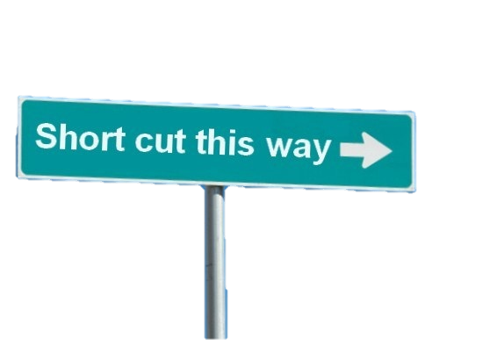
Future Condition
People use cognitive short-cuts in solving problems…heuristics
  These are adaptations for a complex world
    Helpful as they reduce time & effort required to make reasonably good judgments & decisions
  Innate and learned but often subconsciously applied
Notes:
Laura Ragan Notes/Slide:
We make decisions everyday; small, inconsequential decisions. And, BDM research has demonstrated…. We use a host of short cuts to help us make these decisions quickly. They typically serve us well.

Slide 11

But, these cognitive tendencies can lead to, among other hazards:
Future Condition
Failure to identify and properly account for all our objectives
Doing a poor job of predicting the consequences of our proposed actions
These outcomes may result in poorer decision performance: we will be less likely to make decisions that meet our objectives.
Notes:
Laura Ragan Notes/Slide:
We often default to these short cuts for more complex decisions, which can lead to biases and bad decision-making.
Not going to discuss all these, but will talk about a few that are commonly encountered.

Slide 12
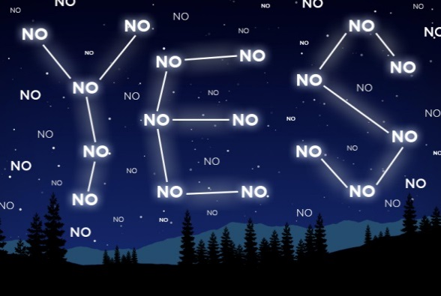
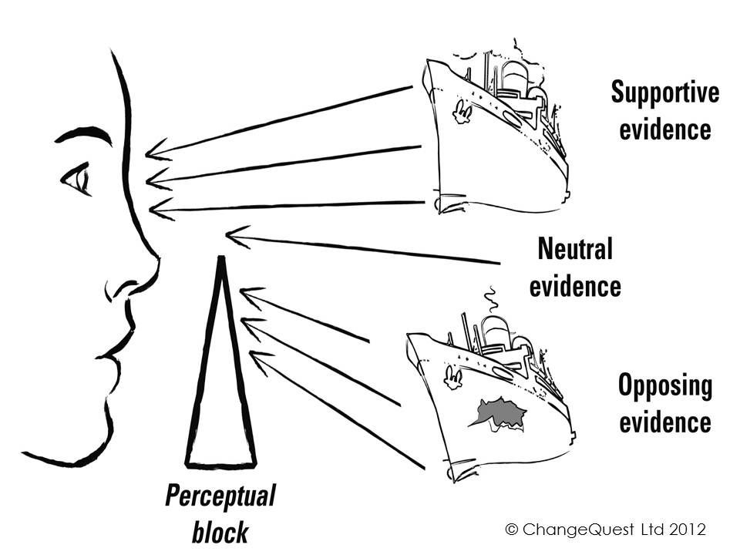
Future Condition
Confirmation bias - tendency to search for, interpret, favor, and recall information in a way that confirms one's preexisting beliefs or hypotheses, while giving disproportionately less consideration to alternative possibilities.
Notes:
Laura Ragan Slide:

Slide 13
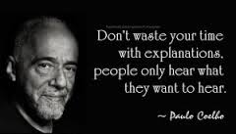
Future Condition
Motivational bias – allow personal self-interests color your decision
Notes:
Laura Ragan Slide:

Slide 14

Overconfidence biases
Future Condition
Experts are susceptible to overconfidence, which leads to a number of associated biases:
Hindsight bias
Narrative fallacy and Illusion of understanding
Illusion of skill
Planning fallacy
Notes:
Laura Ragan Notes:
Need a better slide for this…
Placing better confidence in their estimate than is warranted by data or experience. There is a difference between what they have learned (what they actually know) and what they think they know. Experts can lack humility about what they do not know.
Dave Smith Notes:
Hindsight bias: In retrospect we believe we saw the future coming (I knew it all along), so we now believe we can forecast the future. Chance is discounted and large roles assigned to talent, intelligence, and intention. The net result is miscalibration, i.e., poorly calibrated sense of probability and the future. Hindsight is associated with outcome bias, halo effect, and risk aversion.
Narrative fallacy: We tend to weave stories around facts, which may wrongly increase our impression of understanding; we may also ascribe causal links to facts if we can form a supporting narrative.
Illusion of understanding: We tend to believe we understand complex systems better than we do.
Illusion of skill: Where outcomes are mostly due to chance, we attribute them to skill. Specialists’ forecasting skills are not generally better than non-specialists due to overconfidence.
The planning fallacy: Planning forecasts are almost always too optimistic, i.e., unrealistically close to best case scenarios. We tend to ignore or underestimate variance, the “distributional information,” as well as base rates (failure expectations). This leads to an iIllusion of control and the assumption of exceptionalism/illusion of superiority.

Slide 15
Expert Elicitation
Future Condition
The ‘Good Practices’ approach:
Step 1. Preparing the experts
Step 2. Eliciting expert knowledge & judgment
Step 3. Verifying elicited information
Notes:
Laura Ragan’s Notes:
Expert elicitation uses techniques to guard against these biases. We will demonstrate some of these methods shortly. 4-pint method guards against overconfidence bias; how we select experts guards against motivational bias.
Step 1: Take time to prepare in order for this to work well. Need to prepare yourself and your experts. Make sure they are all starting with the same basic understanding of the species general biology. Discuss with them the heuristics we just talked about.
Step 2: Use the structured process to elicit their knowledge – make sure you knw what questions you want to ask ahead of time (may change, but have them as prepared as you can).

Slide 16
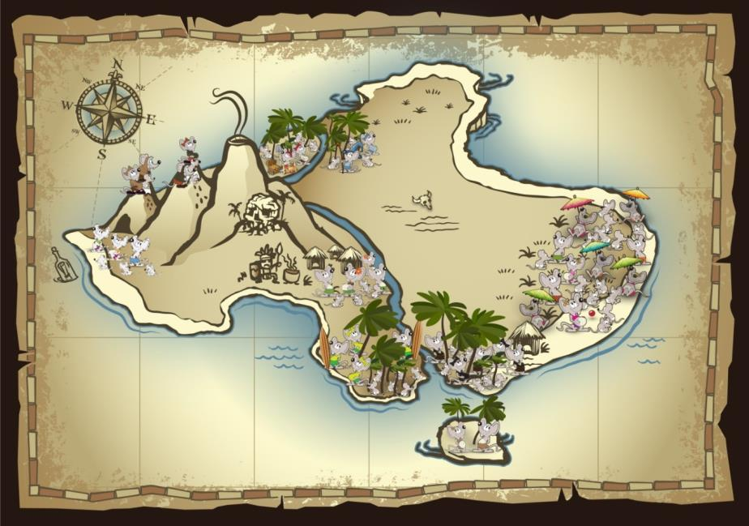

Future Condition
EXERCISE 10.
Projecting Future Condition
Notes:
Introduce exercise first…BUT WAIT! Before they head into their groups, do the demo (forward to next slide).
THEN go into population groups.
Back in population groups to make projections based on expert judgment
Mouse expert for each pop for them to elicit info from. Fill in Future condition Tables, one for each scenario. NEED: Three posters on the wall for pops to fill in (just like current condition).

Slide 17

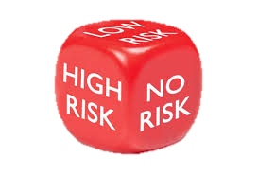
Future Condition
EXERCISE 11.
Characterizing Risk for the Species Over Time

Slide 18

Future Condition
EXERCISE 12. Briefing
the Decisionmakers
Notes:
How do you roll up the SSA information? And then how do you present it to the decisionmakers?
For this exercise, each Ecological Setting will have FIVE minutes to present a briefing to the Director. In your groups, discuss what are the important points to explain, and decide amongst your group members how to do that.
(Format totally open – one person, whole group, whatever works best)
After your five minute presentation, there will be a three minute period for Director questions, followed by five minutes for group feedback.
Wrap-up: Facilitated discussion. Class interacts and comes to agreement on Species scale.
INSTRUCTOR NOTES: Executive Managers or Director: Instructors would fill this role.
Think about holes? What are they NOT telling us? Come up with some basic questions (to use each time).
At what point do we have enough populations?
Should we give up on some of these populations?
How confident are you in the data?
Are there any conservation measures we could be doing and are there any partners helping us do them?

